Slide 1








AI Bootcamp
Data Visualization
Week : 2
Abdulaziz Saud Alsubaie
Osamah Waleed Aldahlan

Slide 2





What is data Visualization?
Data visualization : is the presentation of data in a pictorial or graphical format.

Slide 3
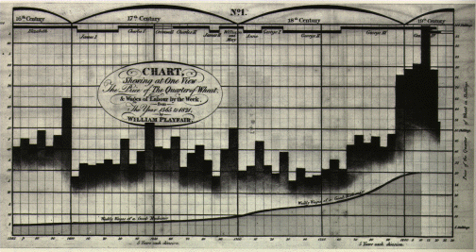

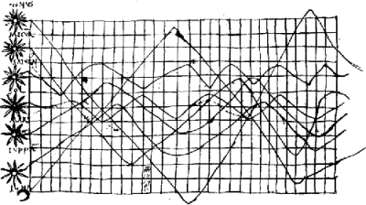

The history of data Visualization

Slide 4



What is the purpose of visualizing data?
Make the Data readable
Helps to make better decisions
Facilitate finding the errors

Slide 5

Requirements
01
Data visualization tool
03
Knowledge of charts
02
Cleaned Data
04
Questions to ask

Slide 6





Data Visualization tools

Slide 7

Power BI Software
The main idea of using data visualization tools is to answer all question required.
How to Visualize Data in Power BI?
Import data
Check the Data in the transform
Insert Graphs
Select Filters

Slide 8

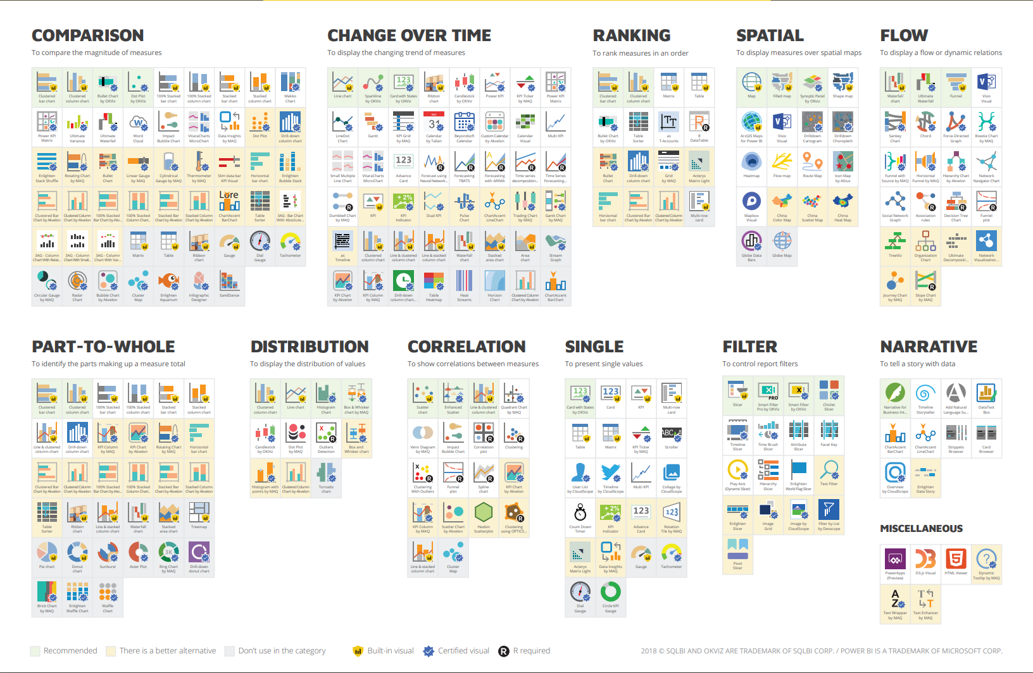
Graphs

Slide 9
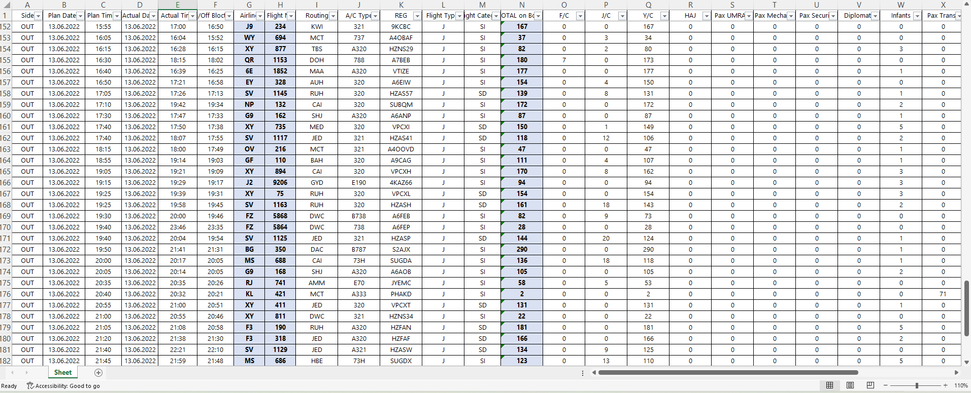
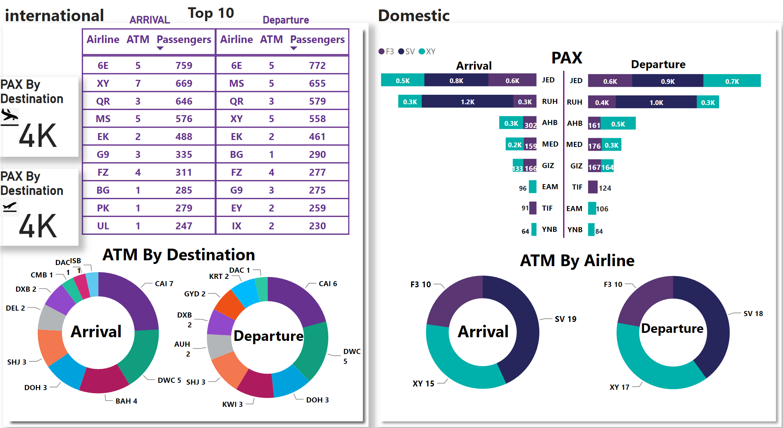
Why should data be visualized
From
To

Slide 10
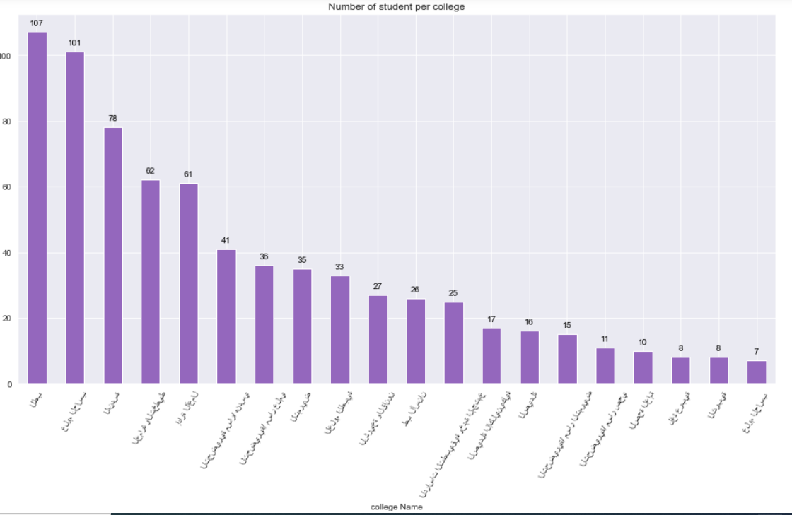
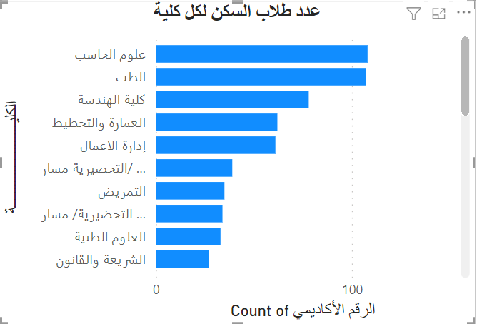
Python VS Power BI

Slide 11
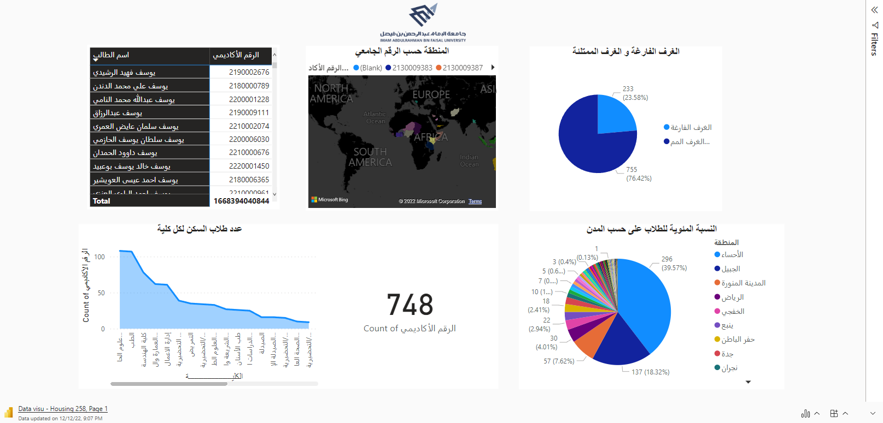
Live Power BI

Slide 12




Experimental Phase
Osamah Aldahlan

Slide 13


Slide 14


Thank You
Abdulaziz Saud Alsubaie
Osamah Waleed Aldahlan

